Slide 1
Matrices

Slide 2
Route Matrices
A
B
How many direct route(s) from one town to the other?
e.g. from A to B, A to D etc.
D
C

Slide 3
A
B
D
C
 | A | B | C | D
A | 0 | 1 | 0 | 0
B | 1 | 0 | 1 | 1
C | 0 | 1 | 0 | 2
D | 0 | 1 | 2 | 0

Slide 4
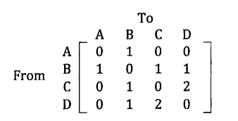
Writing the table in a matrix
direct route matrix (one stage route matrix)

Slide 5
A
B
What about a two-stage route?
How can go from A to A?
What about from A to D?
D
C
What about from B to C?
A
B
A
B
D
C
D
C

Slide 6
How about from C to C?
A
B
A
B
A
B
D
C
D
C
D
C
A
B
A
B
D
C
D
C

Slide 7
How about from D to D?
A
B
A
B
A
B
D
C
D
C
D
C
A
B
A
B
D
C
D
C

Slide 8
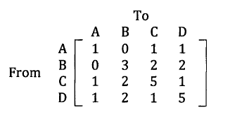
Two stage route matrix

Slide 9
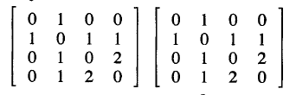
Use your calculator to multiply the one stage route matrix by itself
2
=
=
Conclusion?

Slide 10
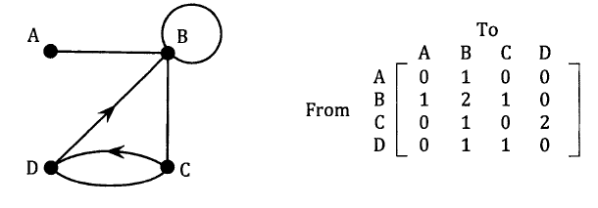

Slide 11
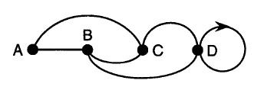
Direct Route Matrix
0 1 1 0
1 0 1 1
1 1 0 1
0 1 1 1
Two Stage Route Matrix
2 1 1 2
1 3 2 2
1 2 3 2
2 2 2 3
To
A B C D
To
A B C D
A
A
From
B
From
B
C
C
D
D

Slide 12
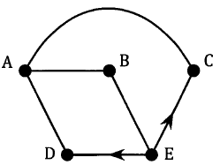
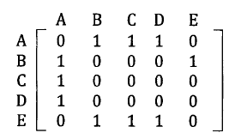
Social Interaction?

